Slide 1
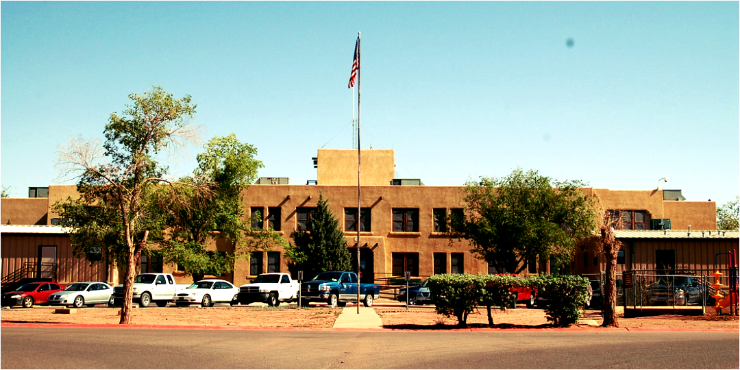
Proposal Defense
Current Breastfeeding Knowledge Score Amongst Southwestern Navajo Women
By: Natalie Reed

Slide 2
Introduction
Minority women, primarily American Indian/Alaskan Native (AI/AN) women, experience a disproportionally high amount of health disparities, directly affecting breastfeeding initiation rates (Quentero et al., 2023)
Breastfeeding rates directly impact the infant’s risk for malnutrition and other chronic diseases such as obesity and Diabetes Mellitus (Zamora-Kapoor & Ka’imi, 2016)
Exclusive breastfeeding is the provision of only breastmilk for the first six months of age, as coined by the World Health Organization (WHO) and the United Nations Infant and Children’s Fund (UNICEF)

Slide 3
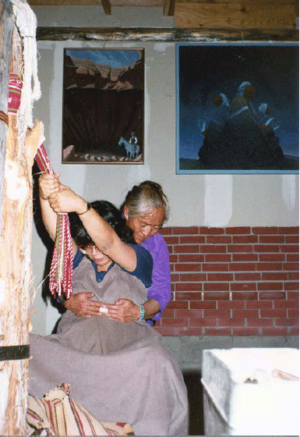
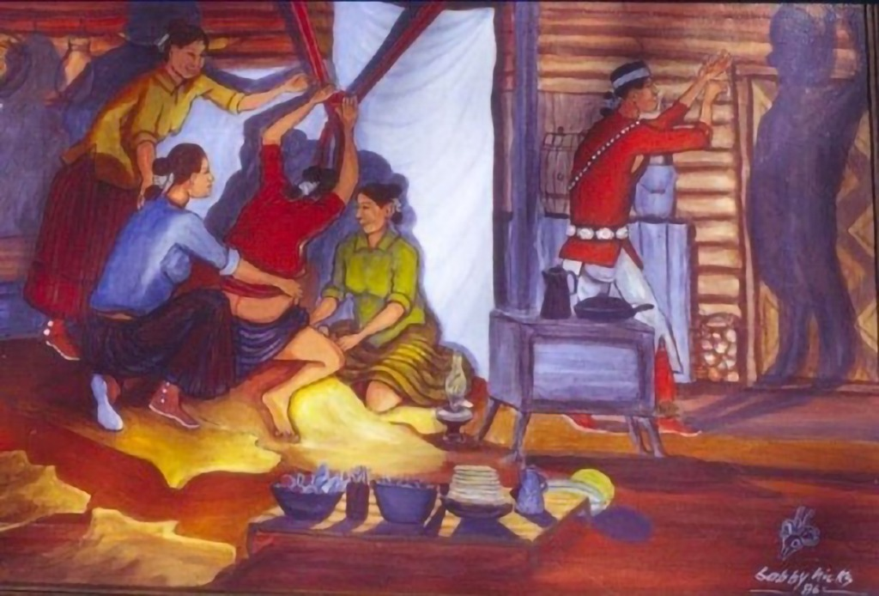
Literature Review
Breastmilk is refereed to as “The First Food” given by the Holy People
-Traditionally, once birthed, the infant is taken to bathe in Yucca suds, the infant is then to be handed to the mother to initiative breastfeeding

Slide 4
Introduction: Literature Review
American Indians and Native Alaskans are found to have a lower EBF rate than compared to other ethnic groups within the United States (Brown et al., 2022).
Gestational diabetes is more commonly diagnosed within the AI/AN population (Asghari et al., 2024).
EBF affects mortality rates by increasing the immune system, strengthening the respiratory system, and decreasing the risk for chronic morbidities, such as type 2 diabetes and obesity (Zhang et al., 2018).

Slide 5
Problem Statement
The problem is that despite a history of breastfeeding health education efforts and movement towards exclusive breastfeeding amongst the Navajo reservation leaders, to the primary investigator’s knowledge, there is no current literature in the past decade regarding breastfeeding knowledge scores amongst Diné women located in the Southwestern region of the Navajo reservation.

Slide 6
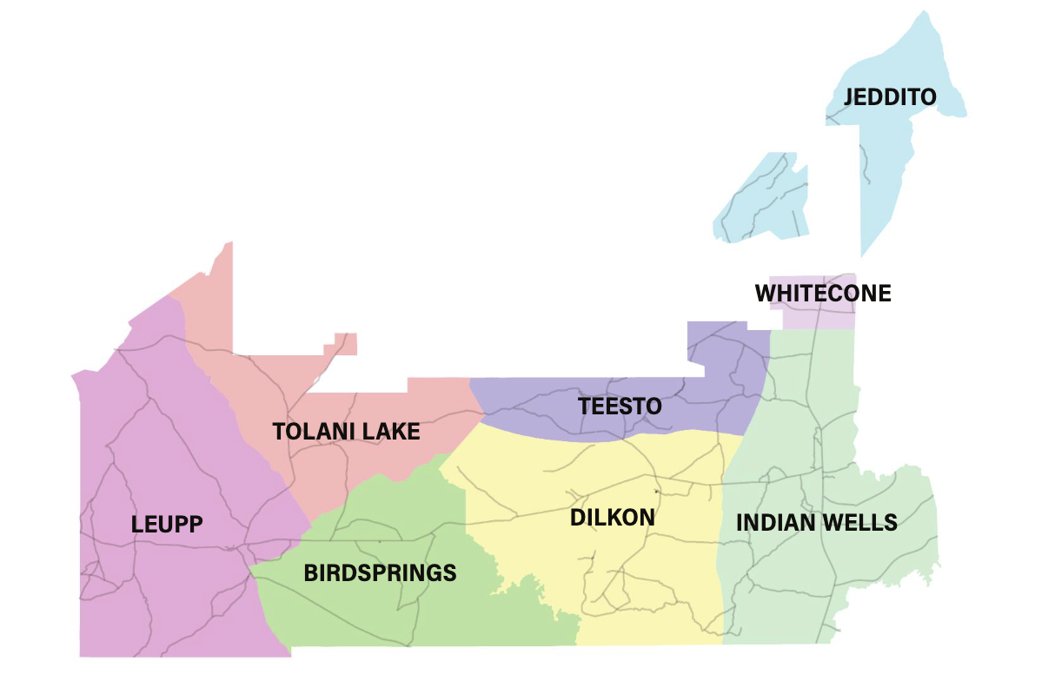
Southwest Region of the Navajo Reservation

Slide 7
Purpose of the Study
The purpose of the proposed study is to obtain relevant breastfeeding knowledge scores which will aid local practitioners in understanding how to tailor breastfeeding education programs

Slide 8
Methodology
The study is an exploratory quantitative, cross-sectional, independent prospective study
A survey known as the Breastfeeding Knowledge Questionnaire, consisting of 28 questions, will be used to gather responses from participating mothers
A thank you gift of a grocery card will be given to participating mothers
Virtual surveys will be made known available at Dilkon Medical Center, Leupp Clinic and Winslow Indian health Care Center

Slide 9
Inclusion criteria: women of the female gender of at least 18 years of age born of Navajo descent
Exclusion criteria: individuals not born female, not a native beneficiary of Navajo descent, under the age of 18

Slide 10
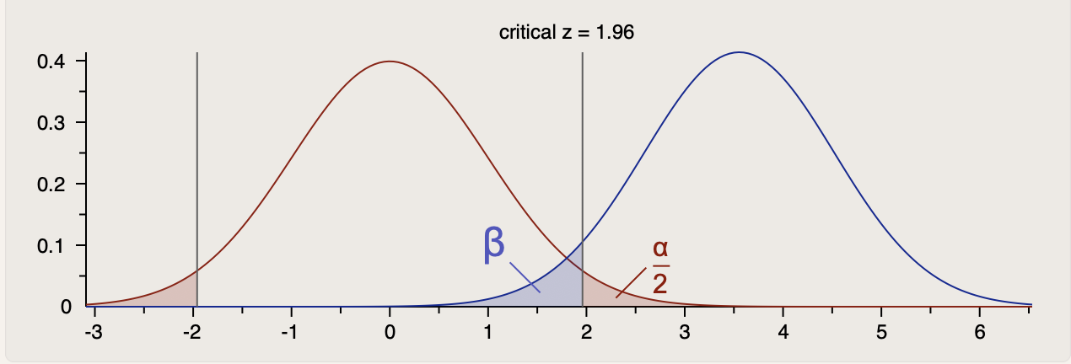
- Dependent Variables: education, employment status and religion
-Independent Variables: Breastfeeding Knowledge Questionnaire Score
- A G* Power Analysis was used to determine sample size
- Goal sample size is 181

Slide 11
-SPSS Software (Version 28) will be used to analyze the data
- The data will be coded into SPSS
-Descriptive statistic frequencies of the socio-demographic data will be rendered
-A t-test will be used to analyze the dichotomous, continuous variables
- Multiple logistic regression will analyze the association between the dependent and independent variables identified in the research questions.

Slide 12
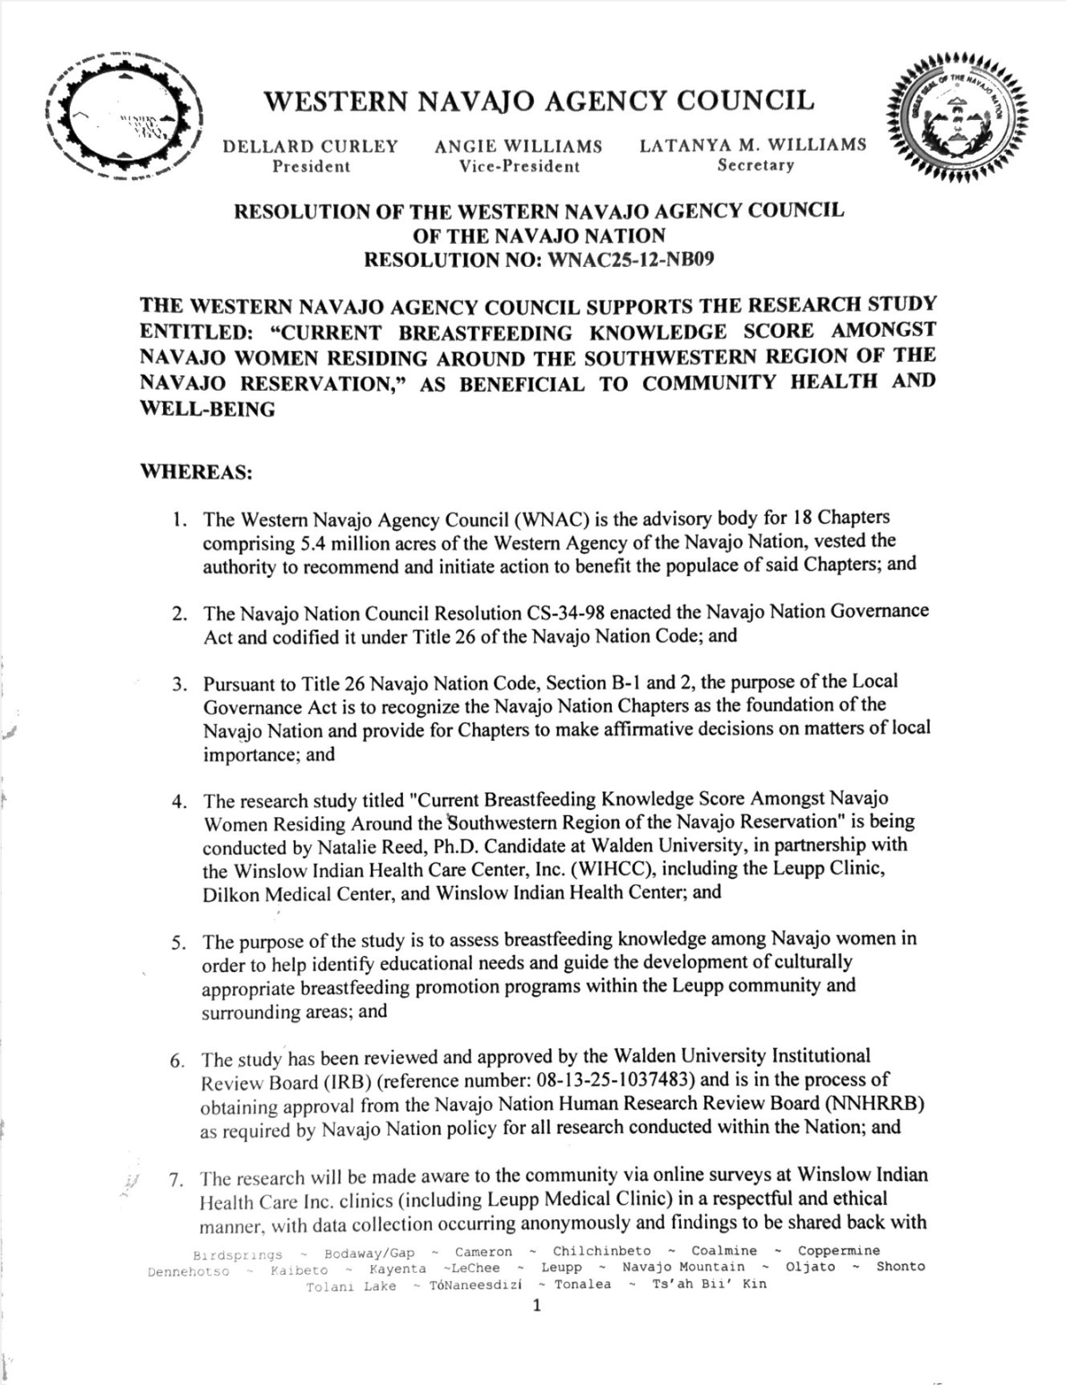
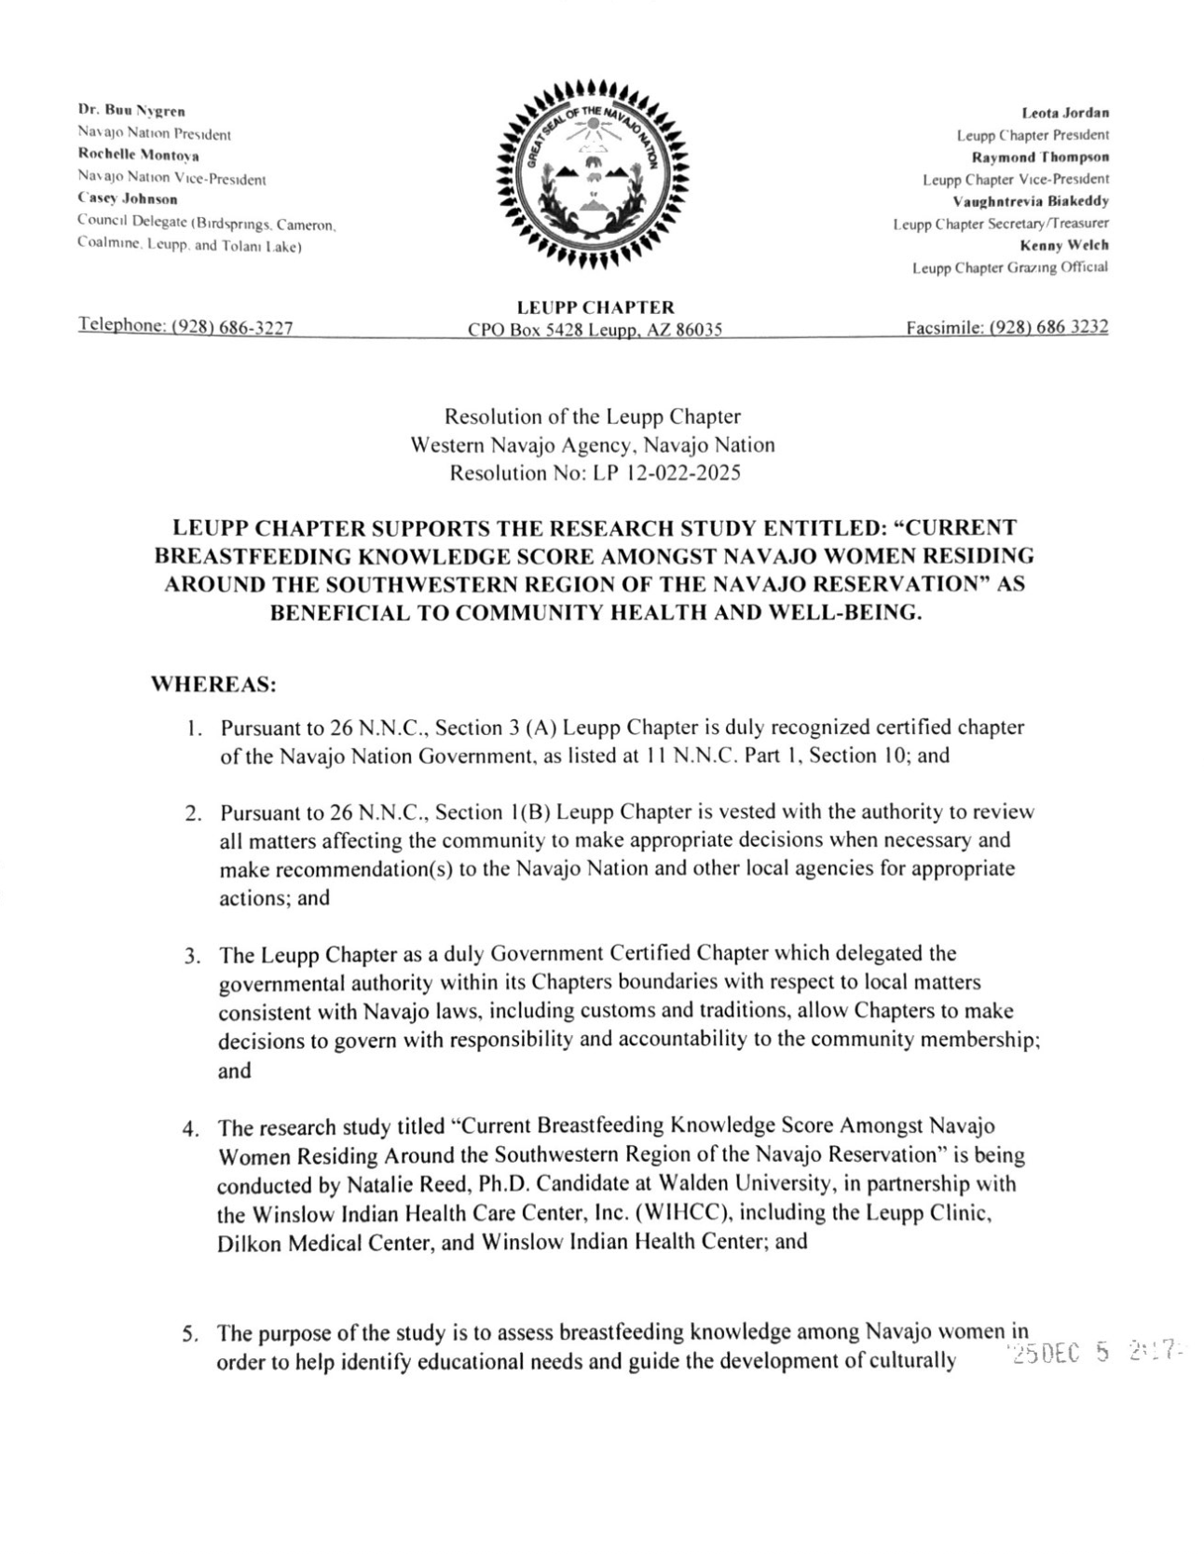
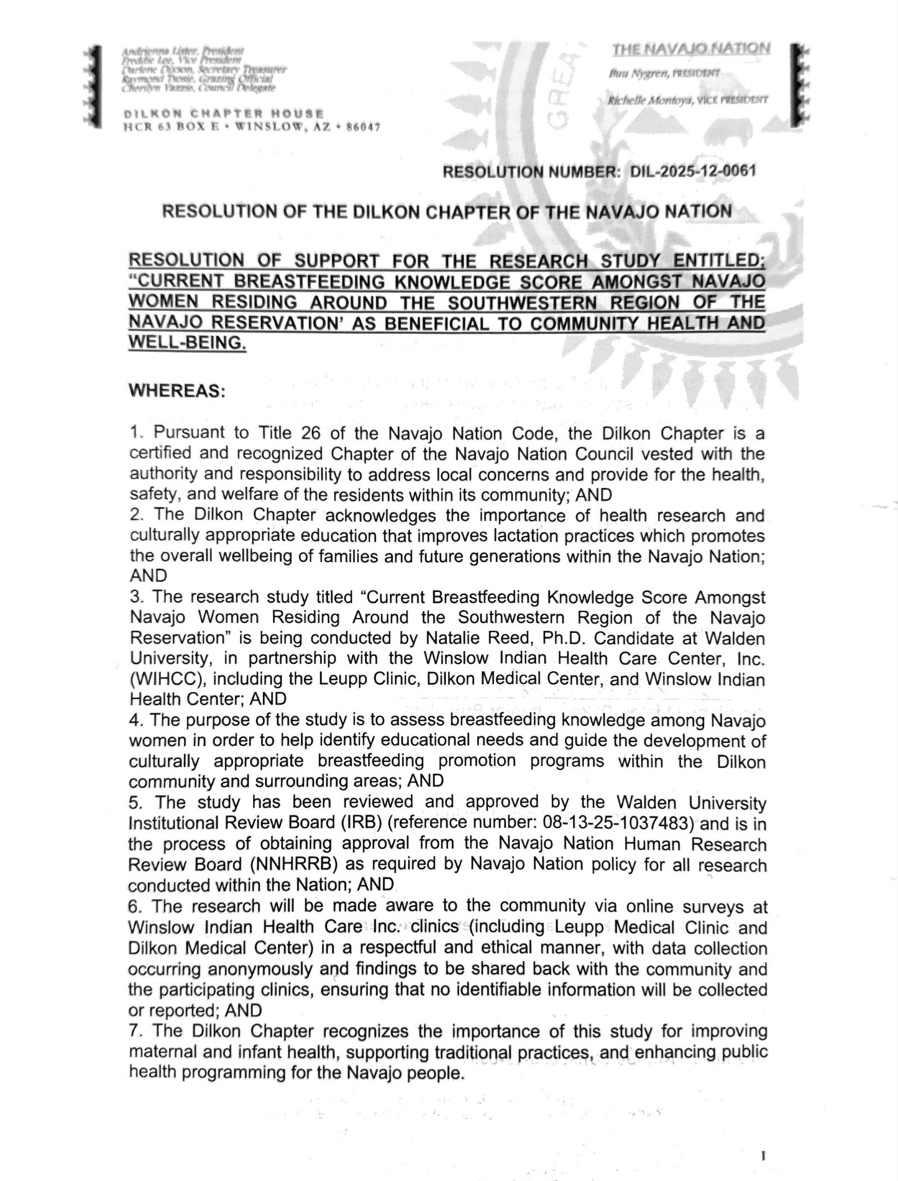

Slide 13
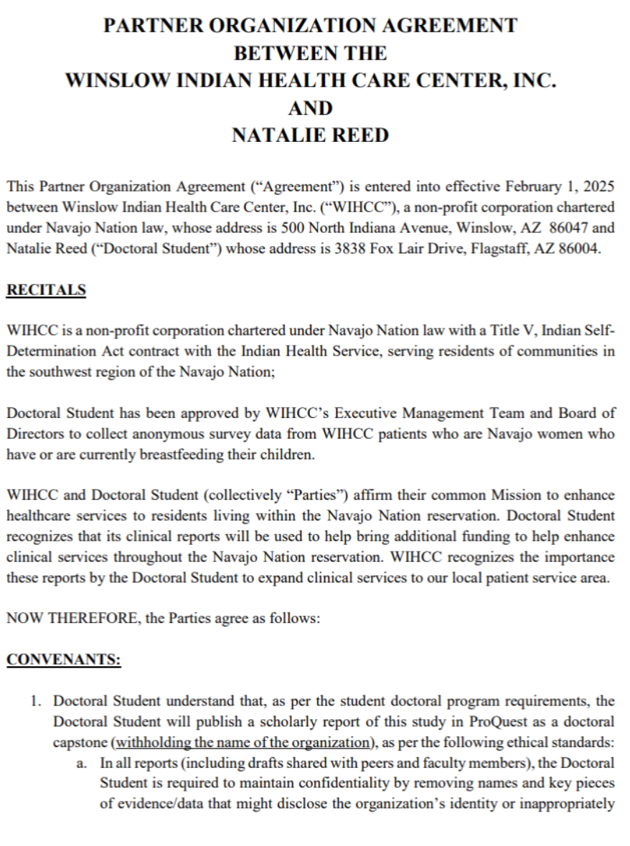
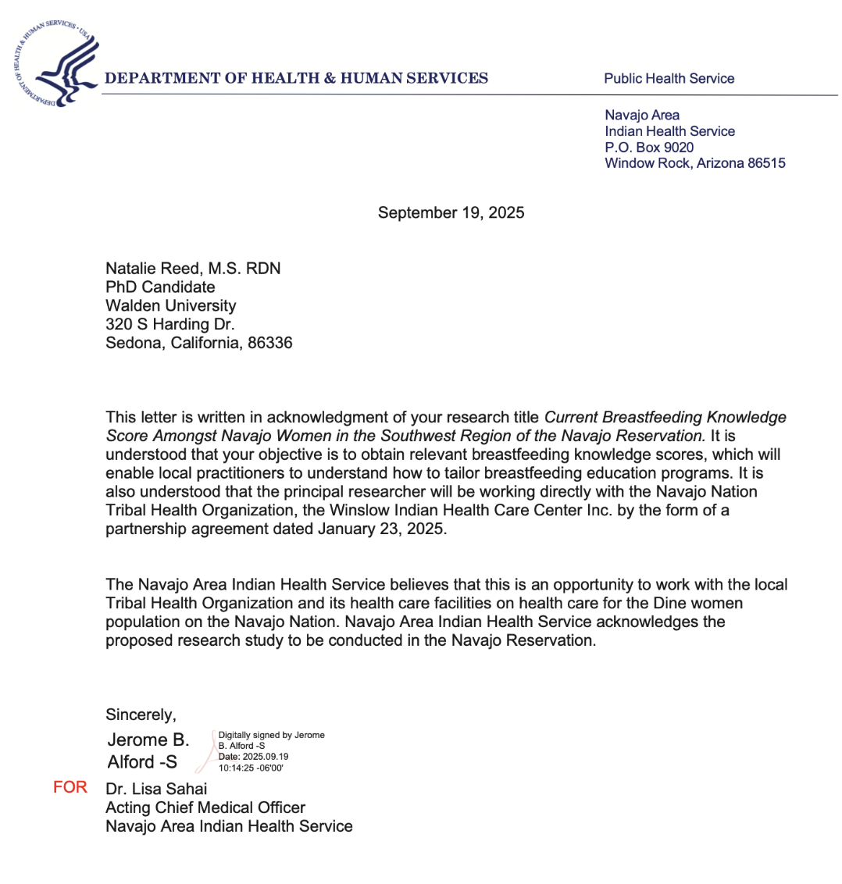

Slide 14
Positive Social Change
Breastmilk holds strong properties important for building the infant’s immune system, strengthening the gastrointestinal system, decreasing allergens, and preventing chronic diseases later in life (Colonetti et al., 2022)
Increasing EBF rates empowers Diné women to strengthen the health of women and children
Understanding social and economic variants that affect EBF choices allows researchers to improve community health programs, enacting social change .

Slide 15
Concluding Thoughts
The proposal requests to collect current Breastfeeding Knowledge Scores amongst Southwestern Navajo women
Relevant breastfeeding data for the Southwestern region of the Navajo reservation will help improve understanding of breastfeeding, which may help strengthen future breastfeeding education programs
An increased understanding of cultural lactation beliefs and practices will aid educators in understanding how to provide optimal lactation support services to the Diné community.
I am requesting approval for the dissertation study,

Slide 16
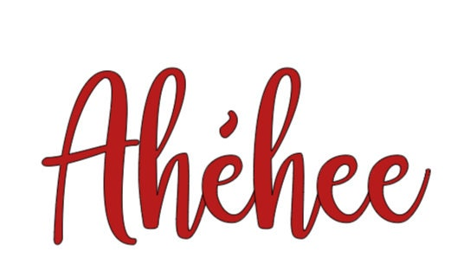
Question & Answer

Slide 17
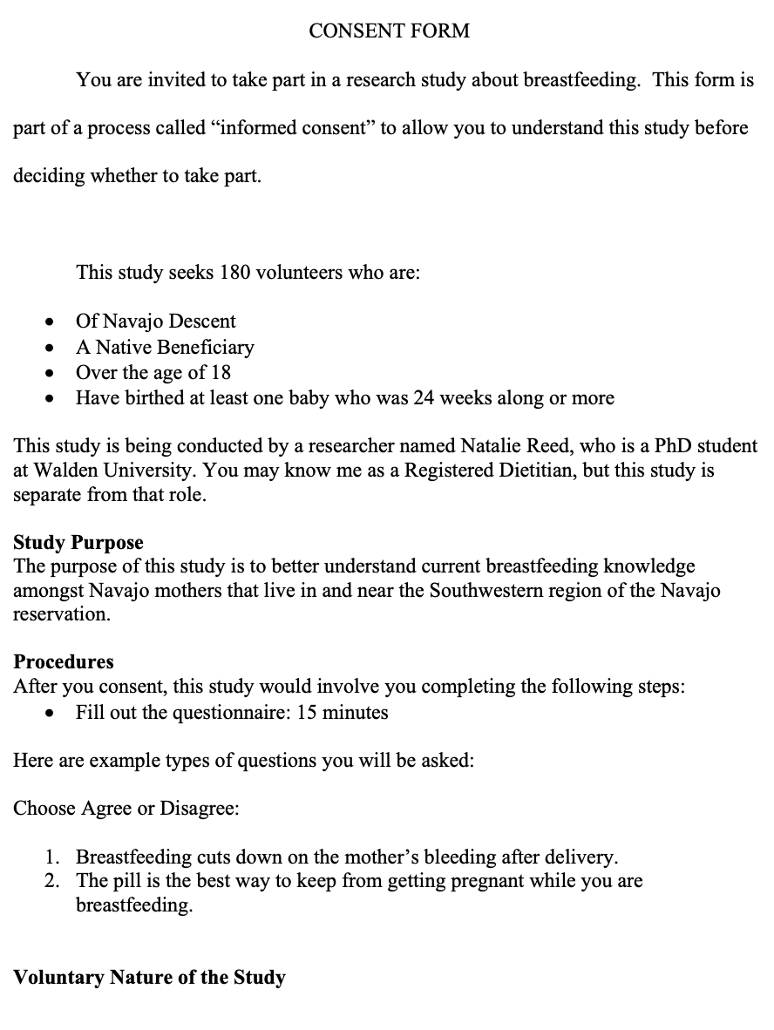
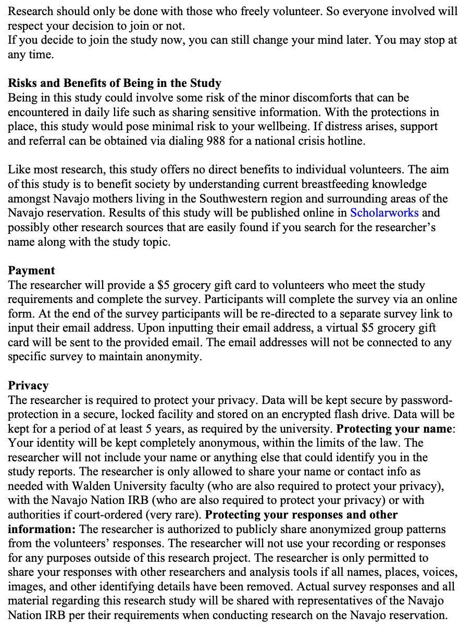
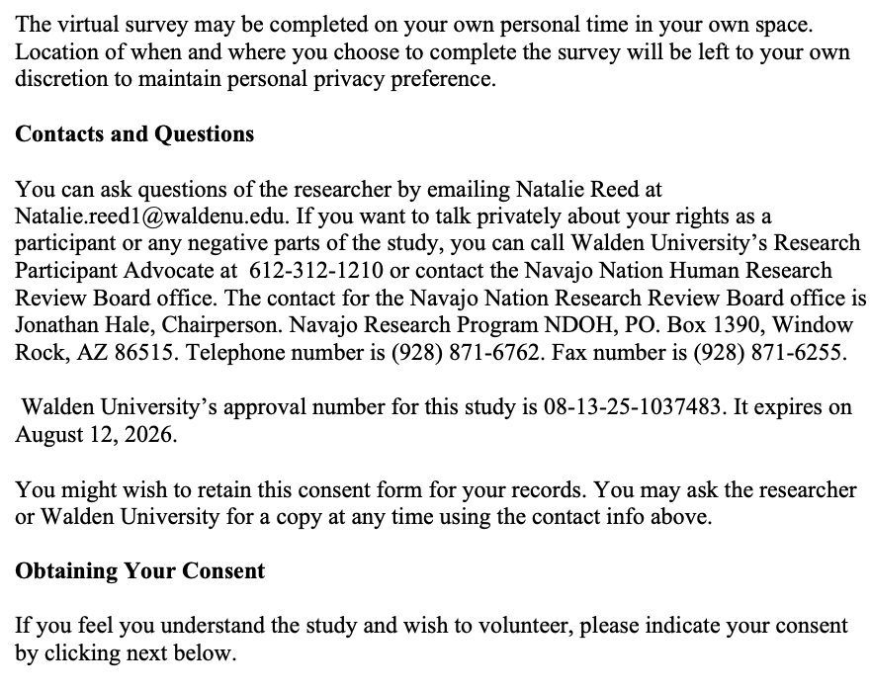
Supporting Documents

Slide 18
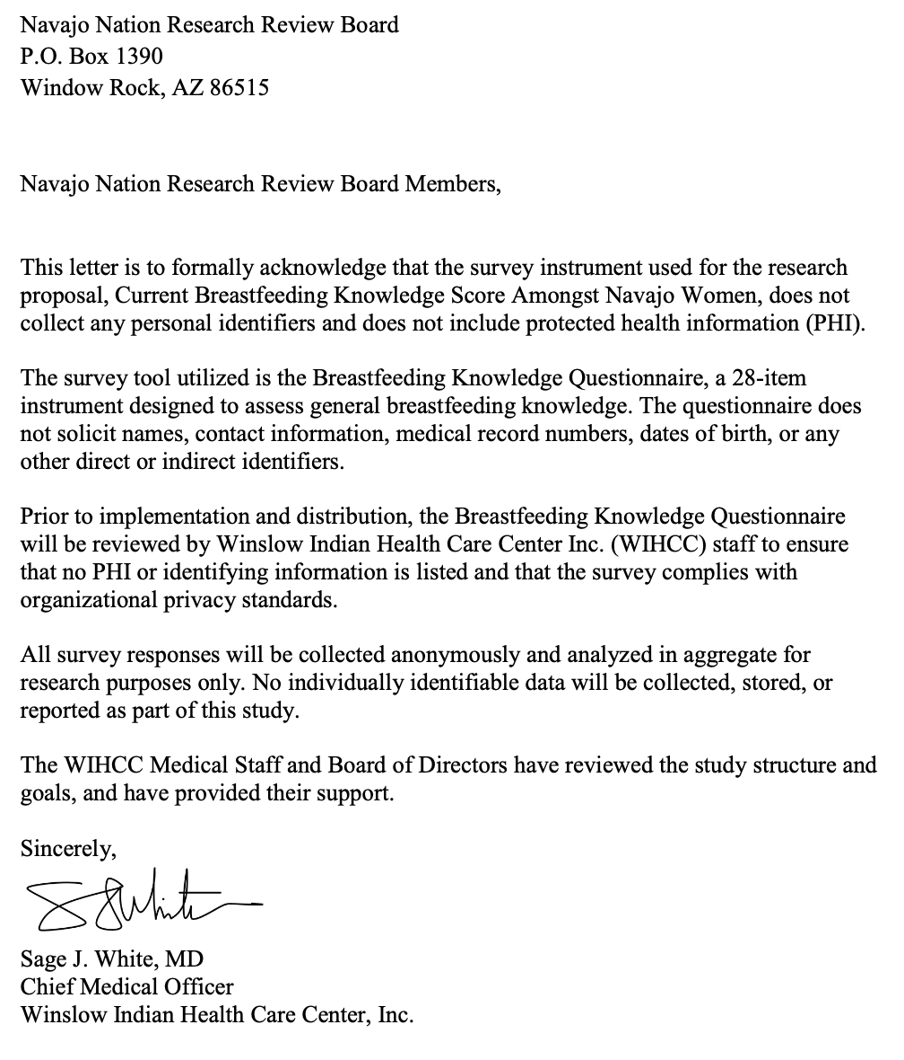
Supporting Documents

